Slide 1
My Mood
My Mood
Username
Username
Password
Password
Login
Create Account
Create Account

Slide 2

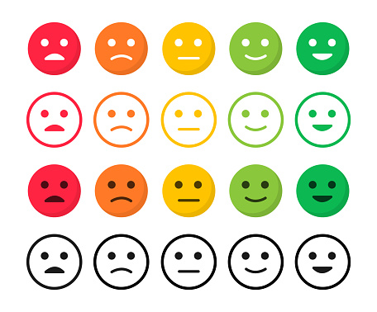


Account
Todays Mood
Name
Mood History
DOB
Age
Todays Notes
Reset Password
Past Days
Log Out
My Account

Slide 3
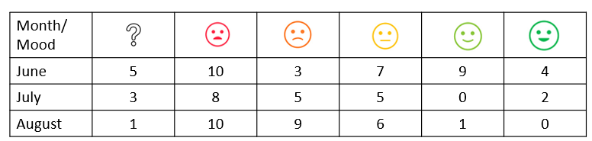
Mood Analytics
Mood Trends
Mood Trends
Mood Trends
Time Period
Time Period
100%
Quantities
0%
June
July
August
Distributions

Slide 4
Mood Trends
Todays Notes
Past Days
Time Period
Date
Text Here….
This Days Mood
The Days Notes Displayed
Here

